Slide 2
Modeling System Reliability
Through Reliability Block Diagrams

Slide 3
Dale Uitto, CMRP, REC, PMP
Dale is a Maintenance and Reliability Executive with 20+ years of experience developing, directing, executing and sustaining World Class Maintenance and Reliability Systems in compliance with ISO 55000 and ISO 44000 standards.
He has worked and consulted in heavy and light industries including oil and gas, chemicals, pharmaceuticals, medical devices, foods, beverages, electromechanical devices, injection molding, packaging, and automation.
He has led and managed teams of solutions-oriented professionals focused on world-class processes.
He is a strategic and tactical hands-on executive with a deep understanding of the role maintenance and reliability excellence plays in world-class manufacturing and how to cross-functionally execute best in class processes.

Slide 4
Vincent Torres, Mechanical Engineer
Vincent Torres works as a mechanical engineer for Pioneer Engineering. In addition to his duties as a rotating machinery vibration analyst, he develops large scale Reliability Block Diagrams and performs Reliability Centered Maintenance facilitations.
His most recent project was to model a coal-fired power plant in its entirety.
He holds both Bachelors and Masters of Science Degrees in Mechanical Engineering from Colorado State University where his graduate work included advanced training in reliability engineering.
He has experience working within the oil and gas, power generation, pharmaceutical, and food industries.

Slide 5
Workshop Introduction
Reliability Block Diagrams are used to identify reliability improvement opportunities
You will learn Hands-On the principles of modeling manufacturing systems using Reliability Block Diagrams
You will learn Hands-On the supportive techniques for measuring system or component reliability including
  Non-Parametric Failure Analysis
    aka Mean Time Between Failures
  Parametric Life Data Analysis
    aka Weibull’s Analysis

Slide 6
Learning Objectives
Capturing Required Data
  System Failure Analysis
  Failure Data Mining
  Criticality Assessments
Availability Calculations
  Inherent Availability
  Operational Availability
Reliability Calculations
  Non-Parametric (Lusser’s Equation) Approach
  Parametric (Weibull’s) Approach
Reliability Block Diagrams
  Calculations
  Simulations

Slide 7
Workshop Disclaimer
This workshop is for Manufacturing Reliability Engineers, we will be presenting basic reliability concepts
  This workshop is not for Statisticians, Academia, OEM Warranty, Product Warranty or Human Safety Reliability
  We will not be covering advanced modeling methods, MLE, MLE-RBA, or Crow-AMSAA
Dr Robert Abernethy (The New Reliability Handbook) recommends Median Ranked Regression (MRR) as the best practice for (reliability) engineers because it provides a graphical plot and its simple
  Our failure population is small, between 2-50
  We have excluded Suspended (secondary failure modes) and right Censored (did not fail) failure data
Notes:
MLE = Maximum Likelihood Estimate
RBA = Reduced Bias Adjustment

Slide 8
Capturing Required Data
Capturing Required Data

Slide 9
System Failure Analysis
A system is made up of hundreds of components each with a unique set of failure modes
Each component has a unique failure mode and unique failure distribution

Slide 10
Failure Data Mining
Calculating Reliability requires a data collection system and data mining
  Today there are Computerized Maintenance Management System (CMMS) that are very effective in data collecting and mining
  It requires accurate failure codes, dates and times, but if done correctly will yield powerful data

Slide 11
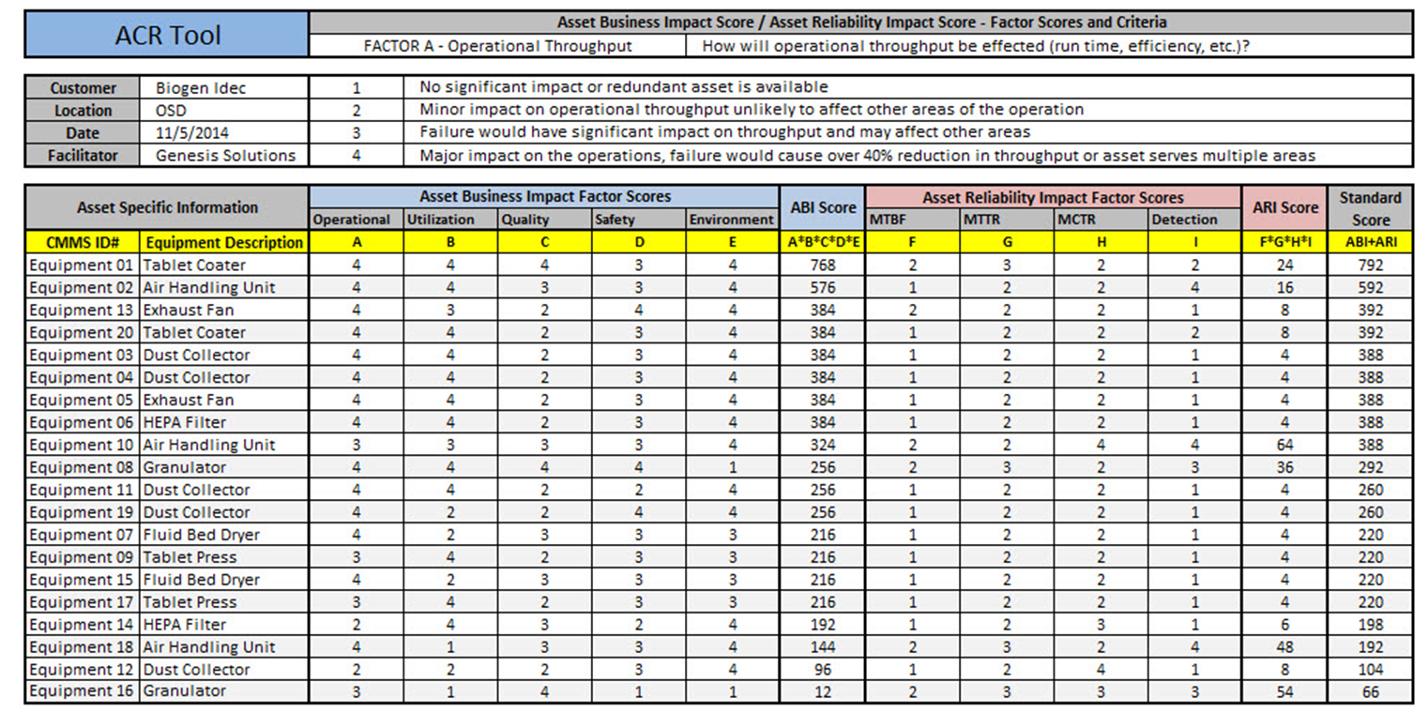
Criticality Assessment
Criticality Assessments defines where to start your Reliability data collection process
Credit to Genesis Solutions

Slide 12
Introduction to Availability
Introduction to Availability

Slide 13
Availability VS. Reliability
Availability tells us how wisely we use our operating window
Reliability tells us the probability that an asset will provide failure free service
Availability IS NOT equal to Reliability
OEE is not a measure of Reliability
MTBF is not a measure of Reliability (no mission time)
You can not improve what you can not measure – Deming
  If your reliability program (RCM) is not data driven you have no program
  Reliability slogans have no place in a reliability program

Slide 14
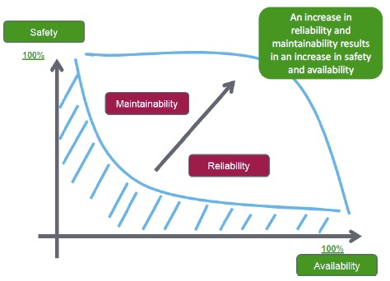
Relationship between Reliability, MTTR and Safety
An improvement availability may not result in improved Reliability, R(t), Maintainability, MTTR
But the inverse, improving Reliability, R(t) has been proven to improve Safety, and Availability

Slide 15
Inherent Availability
Inherent
Availability

Slide 16
Inherent Availability
Inherent Availability (As Designed) is the capability of an asset to perform its intended function satisfactory, as designed, when needed, in a stated environment
Availability is not rate or mission time dependent
  It is either available or not

Slide 17
Inherent Availability
Availability_{i} = MTBF = Uptime
MTBF + MTTR Uptime + Downtime
Availability_{i} = MTBF = 100 = 95%
MTBF + MTTR 100 + 5
Availability is Non-Parametric therefore cannot predict future performance

Slide 18
Operational Availability
Operational Availability

Slide 19
Operational Availability
Operational Availability (As Operated) is the capability of an asset to perform its intended function satisfactory, as operated, when needed, in a stated environment
A_{o} = MTBM
(MTBM + MDT)
Mean Time Between Maintenance (MTBM) includes all scheduled maintenance
Mean Down Time (MDT) includes all time scheduled and non-scheduled downtime, regards of why
Operational Availability is lower than Inherent Availability because of operational abuses

Slide 20
Availability Example
A facility had 72% Operational Availability (28% downtime)
As the facility improved its reliability (by 23%), Operational Availability remained unchanged why?
Operational Availability should have increased to 95%, as downtime was reduced to 5%
  There was no increase in sales or added manpower to take advantage of the added availability
  The legacy of poor reliability gave the facility flexibility (Operational Abuse)

Slide 21
Introduction to Reliability
Introduction to Reliability

Slide 22
Introduction to Reliability
Reliability, R(t) is the probability that an asset or component will perform its intended function for a specific period of time (mission), under stated conditions (performance)
The accuracy of the failure prediction (probability) is dependent on the process used
  Non-Parametric
  Parametric

Slide 23
Introduction to Reliability
Reliability, R(t) can be determined by using one of two methods:
Non-Parametric Analysis, Mean Time Between Failure (MTBF) and Lusser’s Equation
  Treats the entire operating asset as the system
  Uses failure inter-arrival times
  MTBF is not a failure probability distribution
    Two different failures can have identical MTBF
    At best MTBF is a reliability average
    Works best with random System Failures

Slide 24
Introduction to Reliability
Parametric Analysis, Weibull’s Analysis
  Requires the tracking of unique failure modes
  Each failure mode has a unique failure distribution
  Acquiring the necessary failure data can be culturally challenging

Slide 25
Introduction to Non-Parametric Analysis
Introduction to
Non-Parametric Analysis

Slide 26
Introduction to Non-Parametric Analysis
Collect Mean Time Between Failures (MTBF) as Interarrival Times
  MTBF can be measured over an entire asset or a single failure mode
  MTBF will not accurately predict future failures
    At best MTBF is a reliability average
    Two very different failures can have identical Mean Time Between Failures
  Non-Parametric Analysis is a good starting point

Slide 27
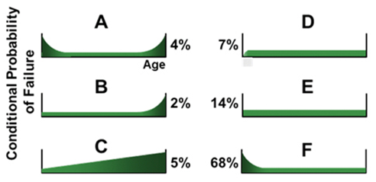
Introduction to Non-Parametric Analysis
For most Reliability Engineers, Mean Time Between Failures (MTBF) is their go-to metric, but
Its not useful in predicting future performance
From the six Conditional Probability of Failure profiles, random failures are dominate

Slide 28
Non-Parametric Analysis
Mean Time to Repair
MTTR

Slide 29
Non-Parametric Analysis
Mean Time To Repair
Mean Time To Repair is the average time needed to restore a failed asset to its full operational condition
Mean Time To Repair is a measure of maintenance effectiveness and asset maintainability
MTTR supports availability, not reliability
MTTR = Total Repair Time = 34 Hours = 6.8 Hours
# of Failures 5 Failures

Slide 30
Non-Parametric Analysis
Repair Rate
Repair Rate μ (MU) is the number of asset repairs per period of time
Repair Rate is relatively constant over the useful life of an asset (its an average over time)
Repair rate is the inverse of Mean Time To Repair (MTTR)
Repair Rate μ = 1 = 1 = 0.147 Repairs per hour
MTTR 6.8

Slide 31
Non-Parametric Analysis
Mean Time Between Failures
MTBF

Slide 32
Non-Parametric Analysis
Mean Time Between Failures
Mean Time Between Failures (MTBF) is a basic measurement of asset availability
Mean Time Between Failure is relatively constant over time of an asset with random failures (average over time)
MTBF is a not a failure distribution or a measure of reliability
MTBF = Mission Time = 347 = 69.4 Weeks (16 Months)
# of Failures 5

Slide 33
Non-Parametric Analysis
Failure Rate
Failure Rate λ (Lambda) is the number of failures of for a given period of time (Mission Time)
The Failure Rate is relativity constant over time of an asset with random failures (average over time)
Failure Rate is not a failure distribution
Failure Rate λ = 1 = 1 = 0.014 per week
MTBF 69.4

Slide 34
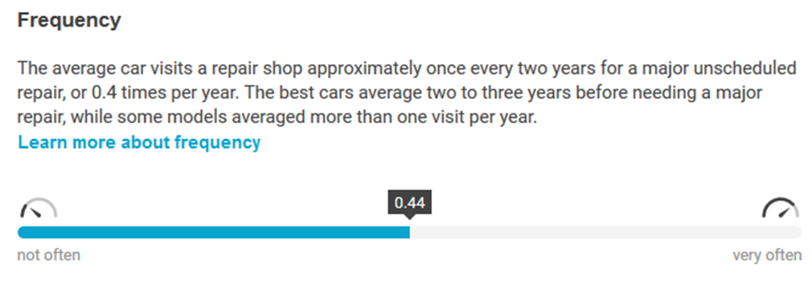
Making Failure Rate Real
According to https://repairpal.com/reliability
Repairpal.com publishes the frequency of major repairs for all vehicles. Here's what they found
The average car has a Failure Rate of .44 failures per year, reliability = 64.9% (year)
The best car has a Failure Rate of .33 failures per year, reliability = 72% (year)
Its all about the Mission Time and Truth in Advertising
J.D. Powers says…….. Blah Blah (mission time of 90 days)

Slide 35
Non-Parametric Analysis
Lusser’s Equation
Lusser’s Equation describes random failures using MTBF data
R(t) = e^{-(λ*t)} = e^{-(t/Q)} = e^{-(N)}
Where:
t = Mission Time (52 weeks)
λ = Failure Rate (0.014 failures per week)
Q = 1/λ or Mean Time Between Failures (69.4)
N = Number of failures during the mission
R(52) = e^{(-0.014*52)} = .473 or 47.3%
R(28.26) = e^{(-0.014*28.26)} = .665 or 66.5%

Slide 36
Making Lusser’s Equation Real
Why do most Reliability Engineers not measure or report reliability?
Management is ecstatic to have a MTBF of 16 months, but MTBF does not represent failure free for 16 months
Would they accept R(52) = 47.3%

Slide 37
Non-Parametric Analysis Conclusion
Reliability always includes a mission time R(t)
When in doubt about the failure modes, start with Mean Time Between Failures and Lusser’s Equation
  It can represent a complex system comprising multiple failure modes and random failures
  Use Lusser’s Equation to determine the Line Level Reliability
You rarely have to explain MTBF when talking with non-technical people

Slide 38
Parametric Analysis
Parametric
Analysis
Life Data Analysis

Slide 39
Parametric Analysis, Weibull’s
Decisions involving asset life-cycle and maintenance can confidently be made from Weibull’s Analysis
Weibull's Analysis can estimate when components should be serviced, “Plan for Every Failure”
  Preventative Maintenance Frequency (PM, PdM)
  Scheduled Replacement Frequency
  Scheduled Repair Frequency
Weibull’s Analysis can help diagnose the root cause
  Infant Mortality
  Random Failures
  Wear Out

Slide 40
Parametric Analysis, Weibull’s
Reliability Engineers can look for unusual circumstances that will help uncover the root cause of a failure
  Poor maintenance practices
  Poor operating conditions
  Poor design
  Poor storage practices (FIFO)

Slide 41
Parametric Analysis, Weibull’s
The accuracy of a Weibull’s Analysis depends on the quality of the data
For a valid Weibull’s Analysis and to interpret the results there are a few requirements
  Time-To-Failure (TTF) for the population
  All data must be from a single failure mode
    The analyst must know the failure mode root causes and be able to segregate them

Slide 42
Parametric Analysis, Weibull’s
Many Reliability Engineers shy away from Weibull’s Analysis because they believe it is too complex and esoteric, high cost, or do not know how
We will break that paradigm
It is true that an understanding of statistics may help with the interpretation
Reliability Engineers can still reap the benefits of Weibull’s Analysis without a strong statistical background
We will demonstrate a very simple process to perform Weibull’s Analysis

Slide 43
Parametric Analysis, Weibull’s
Why is understanding the time and rate at which the populations fails so critical to your Reliability Program
Defines your Risk Based Inspection Interval (RBI)
Defines failure risk and failure frequency to support your Reliability Centered Maintenance Program (RCM/PMO)
Support Fault Tree Analysis and other root cause failure techniques
Supports Reliability Growth Testing
Defines your Spare Part and Inventory Analysis

Slide 44
Parametric Analysis
Weibull’s Using R
Parametric Analysis
Weibull’s Using R

Slide 45
Parametric Analysis
What is R
R is open source software; it can be downloaded for free at the Website: https://www.r-project.org/
Why is this significant:
R calculates β (beta) and η (eta), no need to estimate them
R developed by Bell Labs
R is powerful and it is FREE
It is the backbone of most statistical or reliability software you purchase $$$$

Slide 46
Parametric Analysis
Weibull’s Using R
The accuracy of Weibull’s Analysis depends on the type, quantity, and quality of data being analyzed
There are two categories of data used in a Weibull’s Analysis
  Time-To-Failure (TTF)
  Suspension Data or Right Censored

Slide 47
Parametric Analysis
Weibull’s Time-To-Failure (TTF)
Time To Failure (TTF) is how long a component lasts before failing
It can be measured in hours, weeks, months, or any other unit that defines the populations life
Failure data must be from a single Failure Mode
  Mixing failure modes will skew the results or result in a random failure distribution
  Random failures are independent of time

Slide 48
Parametric Analysis
Weibull’s Time-To-Failure (TTF)
This is our Pump Seal Failure data we will be using
The data is from a single failure mode
And the exact data we used in Non-Parametric Analysis

Slide 49
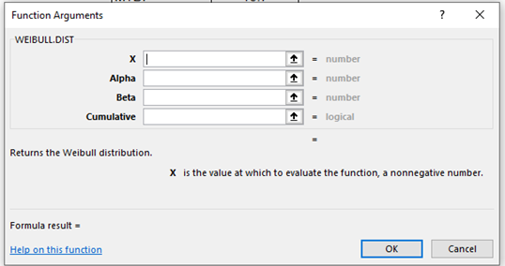
Parametric Analysis
Weibull’s Two Parameters
Two-parameter Weibull’s Analysis is by far the most widely used for life cycle data analysis
Ever wonder where to get the Weibull’s Analysis, Two Parameters β and η
  Excel requires you to estimate β and η
  Minitab is complicated

Slide 50
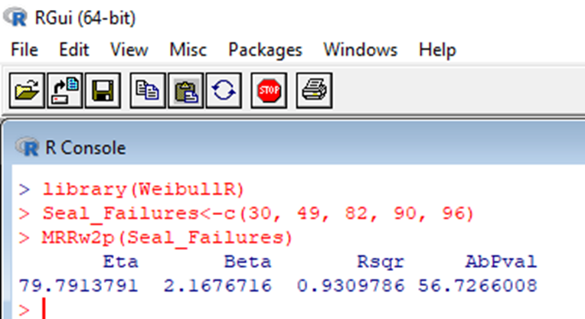
Parametric Analysis
Weibull’s Using R
This is the lines of code we will input into R
library(WeibullR)
Seal_Failures<-c(30, 49, 82, 90, 96)
MRRw2p(Seal_Failures)
It returned the Weibull’s Two Parameters β (beta) and η (eta)

Slide 51
Weibull’s Cumulative (Failure) Distribution Function (CDF)
From Weibull’s Cumulative Distribution Function (CDF) the Probability that a Failure will occur up to time (t)
F(t) = 1 – e^{-(t/η)β}
F(t) = Fraction Failing Up-To-Time t (CDF)
e = Constant Value (2.718) Basis for Natural Log
β = Slope or Shape Parameter (2.168)
t = Failure Time (Mission 28.26 weeks)
η (eta) = Characteristic Life (79.79)
F(28.26) = 1-e^{(28.26/79.79)2.168} = 0.1 or 10%

Slide 52
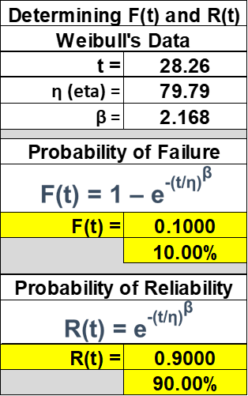
Weibull’s Cumulative (Reliability) Distribution Function (CDF)
The complement to the Weibull’s Cumulative Distribution Function (CDF) is Reliability, R(t), the probability that a failure will not occur up to time (t)
R(t) = e^{-(t/η)β} or R(t) = 1 – F(t)
R(t) = Fraction Not Failing Up-To-Time t (CDF)
e = Constant Value (2.718) Basis for Natural Log
β = Slope or Shape Parameter (2.168)
t = Failure Time (mission 28.26 weeks)
η (eta) = Characteristic Life (79.79)
R(28.26) = 1 - F(28.26) = 0.90 or 90%

Slide 53
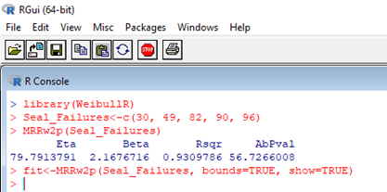
Parametric Analysis
Weibull’s Plot Using R
Weibull’s Plots Using R
This is the lines of code we will input into R
library(WeibullR)
Seal_Failures<-c(30, 49, 82, 90, 96)
fit<-MRRw2p(Seal_Failures, bounds=TRUE, show=TRUE)

Slide 54
Parametric Analysis
Interpreting the Weibull’s Plot
The straight line is the Median Rank Regression (MRR) fitted line.
It representing the two Weibull’s Parameters β and η
Confidence Interval
Bounds 90%
β = Slope 2.168
η (eta) = 79.79

Slide 55
Parametric Analysis
Interpreting the Weibull’s Plot
The Horizontal Scale is a measure of the life, aging or mission (Time to Failure)
The Vertical Scale is the cumulative percentage failed (Unreliability %)
  A Weibull's plot does not represent reliability, it represents unreliability
β (beta) is the Slope of the best fit line or Median Rank Regression (MRR)

Slide 56
Slope β (beta) Slope Definitions
Value of β | Failure Characteristics | If this occurs, suspect the following
β < 1 | Implies infant mortality. If asset survives, the resistance to failure improves with age | Inadequate burn-in Poor manufacturing quality or counterfeit parts Rework or refurbishment problem Preventive Maintenance is not effective, identify the quality issues to resolve failures
β = 1 | Implies random failures. An old part is just as good (or bad) as the new part (independent of age) | Maintenance or human error Failures are inherent, not induced Mixture of failure modes Overhauls are not effective
β > 1 and < 4 | Implies early wear out | Low cycle fatigue (β = 2.5 - 4.0) Ball Bearing Failures (β = 2.0) Roller Bearing Failures (β = 1.5) V Belts (β = 2.5) Corrosion or erosion failure modes (β = 2 – 3.5) Schedule Replacement is appropriate and cost effective
β > 4 | Implies of old age (rapid) wear out or run to failure | Stress Corrosion (β > 5) Inherent material property limitation (brittle materials) Gross manufacturing process problems Small variation in manufacturing or materials Overhauls and inspections are appropriate and cost effective

Slide 57
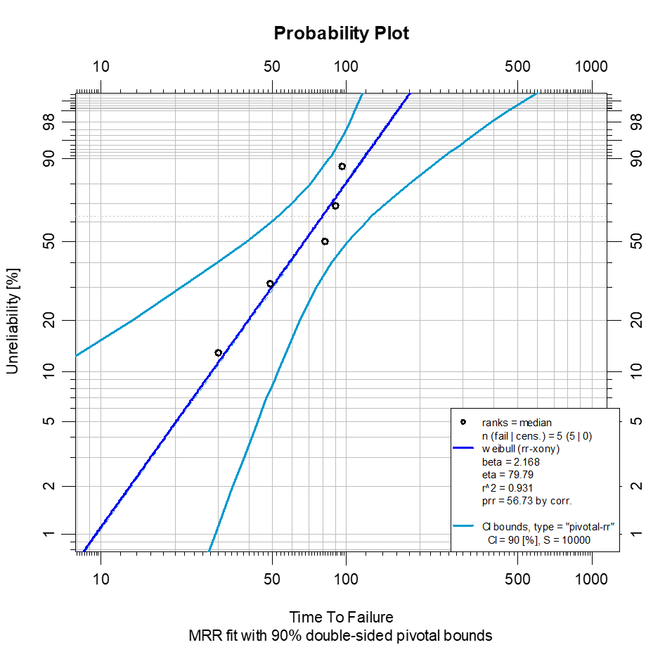
Weibull’s Cumulative (Failure) Distribution Function (CDF)
The Characteristic Life η (eta) is the age when 63.2% of the population has failed
This is true for all Weibull’s Plots
63.2% CDF (Failure)
Intersection with β
R² = 93.1%
Value of η (eta) = 79.79

Slide 58
Weibull’s Cumulative (Failure) Distribution Function (CDF)
η (eta), is equal to the Mean Time to Failure (MTTF) only when the slope β=1, Random Failures
  Mean Time to Failure (MTTF) is average life, not failure
  Where Mean Time Between Failures (MTBF) is average failure

Slide 59
Parametric Analysis
Interpreting the Weibull’s Plot
R² = Goodness of Fit (93.1%)
  R² is a statistical measure of how close the data is to the Median Rank Regression (MRR ) line (β slope)
R² is always between 0 and 100% where:
  0% indicates the model explains none of the variability of the response data around its mean
  100% indicates the model explains all the variability of the response data around its mean.
The higher the R², the better the model fits your data

Slide 60
Parametric Analysis
Measuring Failure Risk
Risk Analysis Using R
ISO 55000 requires the site to define a Risk Tolerance
The populations B Life (Coined by Weibull) is a population’s statistical reliability or failure risk
There are three options to Measure Risk or Risk Tolerance

Slide 61
Parametric Analysis, Measuring
Failure Risk - Mathematically
Option 1: Mathematically calculate B Life using the Weibull’s reliability function (CDF)
R(t) = e^{-(t/η)β}
The reliability function is manipulated to solve for t (time to failure) for the specified B Life
t = η * (-ln R(t))^{1/β}
t = 79.79 * (-ln(0.9))^{0.4613} = 28.26 weeks
At 28.26 weeks 90% will survive, 10% will fail (B10)

Slide 62
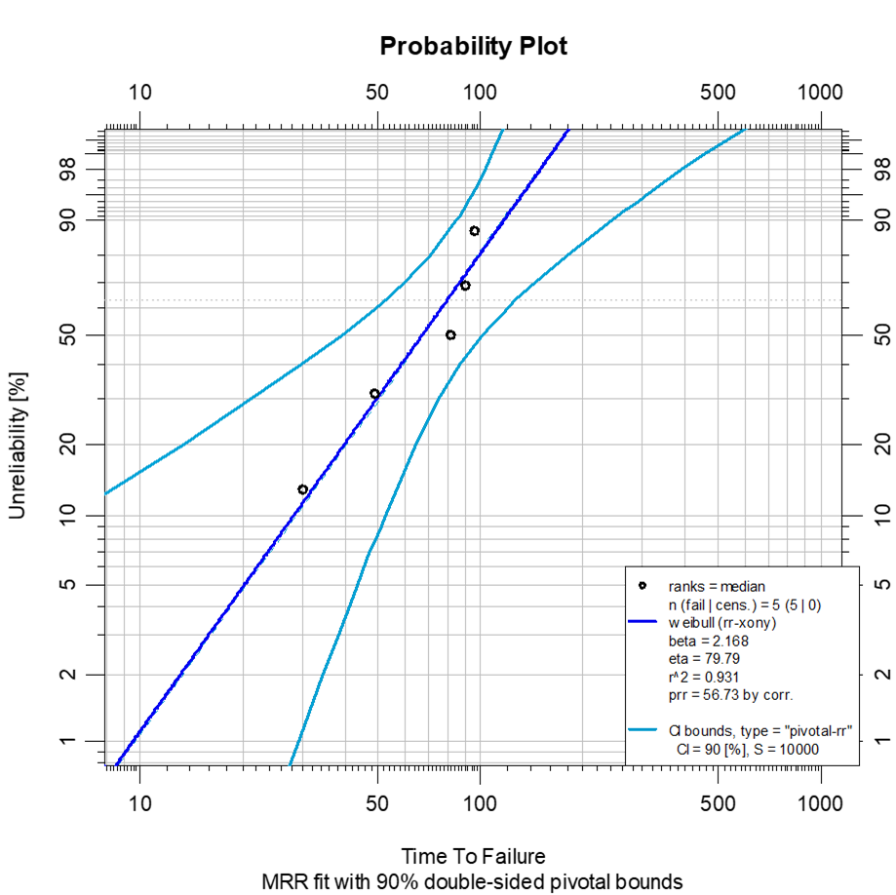
Parametric Analysis, Measuring
Failure Risk From The Weibull's Plot
Option 2: Use the Weibull’s plot to estimate the populations B Life (Coined by Weibull)
Value of η at
B10 ~ 28 weeks

Slide 63
Parametric Analysis
Measuring Failure Risk From R
Option 3: Use R to calculate the B Life
This is the lines of code we will input into R
library(WeibullR)
Seal_Failures<-c(30, 49, 82, 90, 96)
MRRw2p(Seal_Failures)
fit<-MRRw2p(Seal_Failures, bounds=TRUE, show=TRUE)
obj1<-wblr(Seal_Failures)
obj1<-wblr.fit(obj1)
obj1<-wblr.conf(obj1, lwd=1)
plot(obj1)

Slide 64
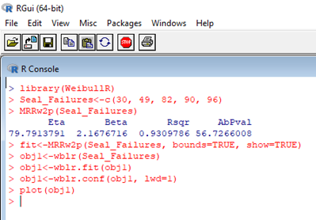
Parametric Analysis
Measuring Failure Risk From R
B10 = 28.25 Weeks
B5 = 20.27 Weeks
B1 = 9.5 Weeks
With a 95% CL

Slide 65
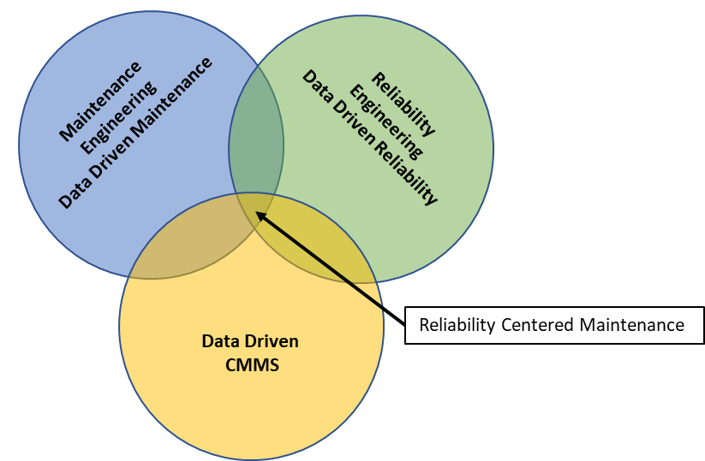
Data Driven Maintenance, Determining PM Frequency using Risk
What is the significance to understanding Failure Risk?
Brings probability of failure risk to your Preventative Maintenance Strategy (“Plan for Every Failure”)
Understanding risk is the foundation of your Reliability Centered Maintenance Program (RCM/PMO)
Risk is the foundation for Risk Based Maintenance or Risk Based Inspection (RBI)

Slide 66
Data Driven Maintenance, Determining PM Frequency using Risk
If you know there is a 10% risk of failure at 28.26 weeks, should that not be your maintenance frequency starting point (or B1, B9.5, B25 weeks)
  Schedule component replacement
  Scheduled component repair, or rebuild
  Your RCM program without data is Speculation Centered Maintenance
Whatever B Life you chose, do it with data

Slide 67
Comparing Non-Parametric vs. Paramedic Analysis
Lusser’s Equation should only be used to determine system reliability and with random failures β ~ 1
  Our data was not random, β = 2.168 (wear out)
Weibull’s should only be used to determine component reliability with a single failure mode
  Then use Reliability Block Diagrams to determine the entire system reliability

Slide 68
What More Information About R
References:
The New Reliability Handbook, Robert Abernathy, 2007
The New Weibull Handbook, Robert B. Abernethy, 2004
William Q. Meeker and Luis A. Escobar, Statistical Methods for Reliability Data, 1998
John I. McCool, Using the Weibull Distribution: Reliability, Modeling and Inference, 2012

Slide 69
Introduction to Reliability Block Diagrams
Introduction to Reliability Block Diagram

Slide 70
Introduction to Reliability Block Diagrams
A Reliability Block Diagram (RBD) is a graphical representation of the system and how they are linked through their reliability
  Through Reliability Block Diagrams we can calculate the overall system’s reliability
  Then select components or subsystems for reliability improvement

Slide 71
Introduction to Reliability Block Diagrams
  There are 3 types of systems:
  Series Systems
  Non-Redundant Parallel Systems
  Redundant Parallel Systems (K out of N)
Each systems effective reliability is calculated differently
These 3 Systems can be interconnected to make Complex Systems

Slide 72
Reliability Block Diagrams
Series Systems
Series System
Shows the systems dependency on the previous component's reliability
Every component must operate for the system to function
Calculating a Series System Reliability
Series System Reliability = R1 * R2 *R3
Series System Reliability=0.9*0.9*0.9= 0.729 (72.9%)

Slide 73
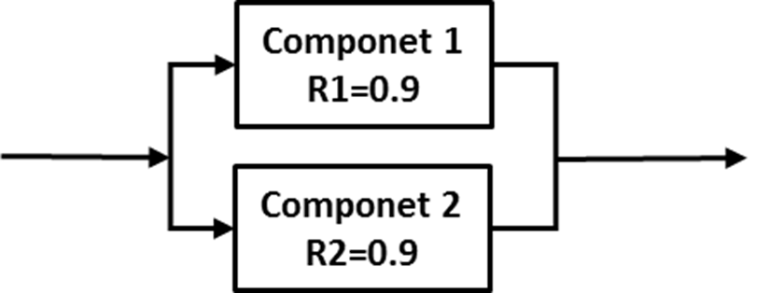
Reliability Block Diagrams
Non-Redundant Parallel Systems
Non-Redundant Parallel System
Treated like a series system, every component must operate to achieve the full rate
Calculating a Non-Redundant Parallel System Reliability
2 out of 2 components must operate for the system to achieve the full rate.
Parallel System Reliability = R1 * R2
Parallel System Reliability = 0.9 * 0.9 = 0.81 (81%)

Slide 74
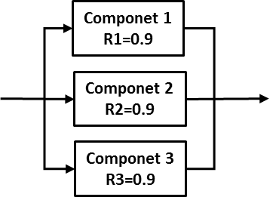
Reliability Block Diagrams
Non-Redundant Parallel Systems
Calculating a Non-Redundant Parallel System Reliability
3 out of 3 components must operate for the system to achieve the full rate.
Parallel System Reliability = R1 * R2 * R3
Parallel System Reliability=0.9*0.9*0.9=0.729 (72.9%)

Slide 75
Reliability Block Diagrams
Redundant Parallel Systems (K out of N)
Redundant Parallel (K out of N)
Shows system reliability when a specific number of components are required to function for the system to operate at full rate, 1 out of 2 pumps
  Not every component is required to operate to achieve the full rate
  This system has an operational spare (hot spare)

Slide 76
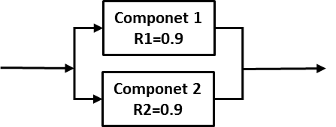
Reliability Block Diagrams
Redundant Parallel Systems (1 out of 2)
Calculating a Redundant Parallel System Reliability
1 out of 2 components must operate for the system to function at full rate
1 out of 2 System Reliability = [1 - (1 – R1) * (1-R2)]
1 out of 2 System Reliability = [1 – (0.1) * (0.1)] = 0.99 (99%)

Slide 77
Reliability Block Diagrams
Redundant Parallel Systems (1 out of 3)
Calculating a Redundant Parallel System Reliability
1 out of 3 components must operate for the system to function at full rate
1 out of 3 System Reliability=[1-(1–R1)*(1-R2)*(1-R3)]
1 out of 3 System Reliability [ (0.1)*(0.1)*(0.1)]=0.999 (99.9%)

Slide 78
Reliability Block Diagrams
Redundant Parallel Systems (2 out of 3)
Calculating a Redundant Parallel System Reliability
2 out of 3 components must operate for the system to function at full rate
2 out of 3 System Reliability=R1*R2*R3+(1-R1) *R2*R3+(1-R2)*R1*R3+(1-R3)*R1*R2
2 out of 3 Reliability 0.729+0.081+0.081+0.081=0.972 (97.2%)

Slide 79
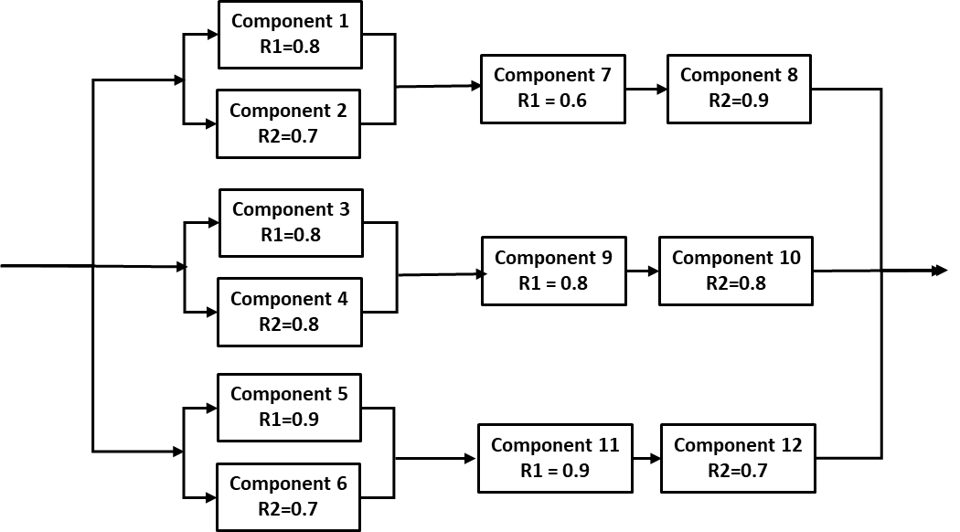
Reliability Block Diagrams
Complex Systems
Complex Systems are the combination of:
  Series Systems
  Non-Redundant Parallel systems
  Redundant Parallel Systems (K Out Of N)

Slide 80
Reliability Block Diagrams Simulation
Reliability Block Diagrams Simulation

Slide 81
Reliability Block Diagrams Simulation of a Series Systems
Improving the Reliability of a Series Systems
A Series System is dominated by its weakest component

Slide 82
Reliability Block Diagrams Simulation of a Series Systems
Live Exercise
Improving the Reliability of a Series System
Based on what we have reviewed which component should be improve?
What is the new system reliability?

Slide 83
Reliability Block Diagrams Simulation of a Series Systems
Live Exercise
Improving the Reliability of a Series System
If we focus on the middle component
The system reliability improves to 56.7% (50.4%)

Slide 84
Reliability Block Diagrams Simulation of a Series Systems
Live Exercise
Improving the Reliability of a Series System
If we focus on the strongest component
The system reliability improves to 53.2% (50.4%)

Slide 85
Reliability Block Diagrams Simulation of a Series Systems
Live Exercise
Improving the Reliability of a Series System
If we focus on the weakest component
The system reliability improves to 64.8% (50.4%)

Slide 86
Reliability Block Diagrams Simulation of a Series Systems
Improving Reliability of a Series System
Our first inclination is to fix the weakest component
Only by using a simulation technique can we determine the most cost-effective course of action

Slide 87
Reliability Block Diagrams, Simulation Non-Redundant Parallel Systems
Improving Reliability of a Non-Redundant Parallel System (Similar to Series Systems)
A Non-Redundant Parallel System is dominated by the weakest component

Slide 88
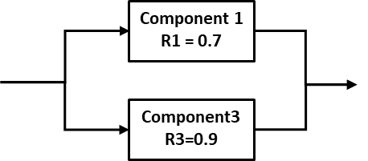
Reliability Block Diagrams, Simulation Non-Redundant Parallel Systems
Live Exercise
Improving the Reliability of a Non-Redundant Parallel System (2 out of 2)
Based on what we have reviewed which component should be improve?
What is the new system reliability?

Slide 89
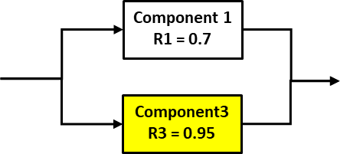
Reliability Block Diagrams, Simulation Non-Redundant Parallel Systems
Live Exercise
Improving the Reliability of a Non-Redundant Parallel System (2 out of 2)
If we focus on the strongest component
The new system reliability is 66.5% (63.0%)

Slide 90
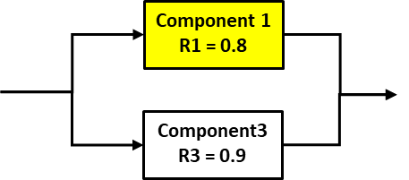
Reliability Block Diagrams, Simulation Non-Redundant Parallel Systems
Live Exercise
Improving the Reliability of a Non-Redundant Parallel System (2 out of 2)
If we focus on the weakest component
The new system reliability is 72.0% (63.0%)

Slide 91
Reliability Block Diagrams, Simulation Non-Redundant Parallel Systems
  Improving the Reliability of a Non-Redundant Parallel System (2 out of 2)
  Our first inclination is to fix the weakest component
Only by using a simulation technique can we determine the most cost-effective course of action

Slide 92
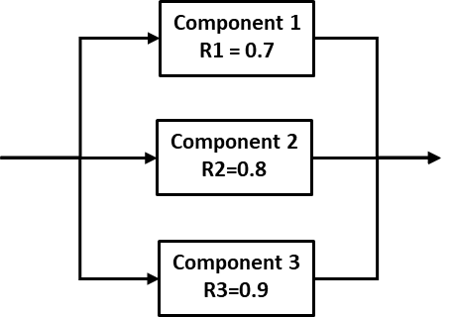
Reliability Block Diagrams, Simulation Non-Redundant Parallel Systems
Live Exercise
Improving the Reliability of a Non-Redundant Parallel System (3 out of 3)
Based on what we have reviewed which component should be improve?
What is the new system reliability?

Slide 93
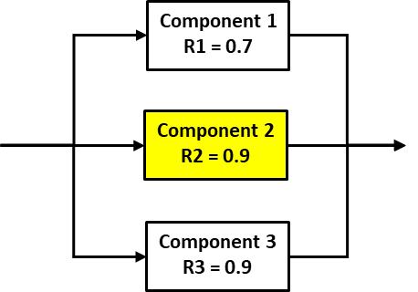
Reliability Block Diagrams, Simulation Non-Redundant Parallel Systems
Live Exercise
Improving the Reliability of a Non-Redundant Parallel System (3 out of 3)
If we focus on the middle component
The new system reliability is 56.7% (50.4%)

Slide 94
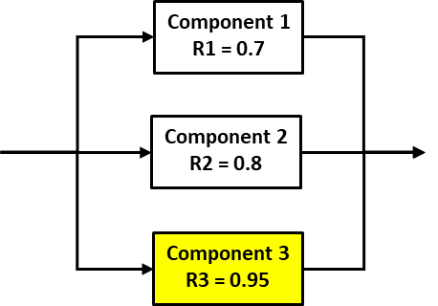
Reliability Block Diagrams, Simulation Non-Redundant Parallel Systems
Live Exercise
Improving the Reliability of a Non-Redundant Parallel System (3 out of 3)
If we focus on the strongest component
The new system reliability is 53.2% (50.4%)

Slide 95
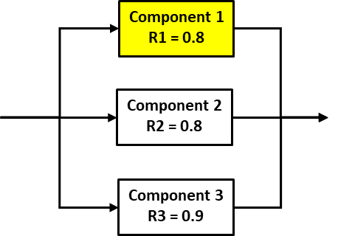
Reliability Block Diagrams, Simulation Non-Redundant Parallel Systems
Live Exercise
Improving the Reliability of a Non-Redundant Parallel System (3 out of 3)
If we focus on the weakest component
The new system reliability is 57.6% (50.4%)

Slide 96
Reliability Block Diagrams, Simulation Non-Redundant Parallel Systems
  Improving the Reliability of a Non-Redundant Parallel System (3 out of 3)
  Our first inclination is to fix the weakest component
Only by using a simulation technique can we determine the most cost-effective course of action

Slide 97
Reliability Block Diagrams, Simulation Redundant Parallel Systems
Improving Reliability of a Redundant Parallel System (K out of N)
  Redundant Parallel Systems can be dominated by the strongest or the weakest components
  Systems such as 1 out of 3, the strongest component will dominate

Slide 98
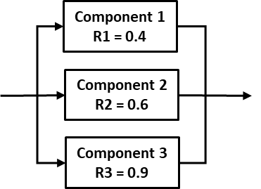
Reliability Block Diagrams, Simulation Redundant Parallel Systems
Live Exercise
Improving the Reliability of a Redundant Parallel
System (1 out of 3)
Based on what we have reviewed which component should be improve? Why?
What is the new system reliability?
Why improve any component?

Slide 99
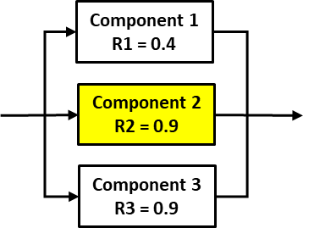
Reliability Block Diagrams, Simulation Redundant Parallel Systems
Live Exercise
Improving the Reliability of a Redundant Parallel
System (1 out of 3)
If we focus on the middle component
The new system reliability is 99.4% (97.6%)

Slide 100
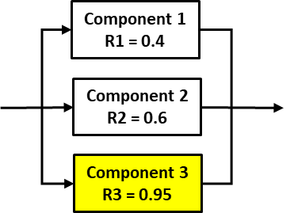
Reliability Block Diagrams, Simulation Redundant Parallel Systems
Live Exercise
Improving the Reliability of a Redundant Parallel
System (1 out of 3)
If we focus on the strongest component
The new system reliability is 98.8% (97.6%)

Slide 101
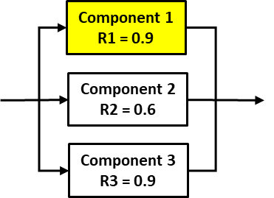
Reliability Block Diagrams, Simulation Redundant Parallel Systems
Live Exercise
Improving the Reliability of a Redundant Parallel
System (1 out of 3)
If we focus on the weakest component
The new system reliability is 99.6% (97.6%)

Slide 102
Reliability Block Diagrams, Simulation Redundant Parallel Systems
  Improving the Reliability of a Redundant Parallel System (1 out of 3)
Our first inclination is to fix the weakest component
  It may be the easiest to improve, what is the ROI for the level of effort required
Only by using a simulation technique can we determine the most cost-effective course of action

Slide 103
Reliability Block Diagrams, Simulation Redundant Parallel Systems
Live Exercise
Improving the Reliability of a Redundant Parallel
System (2 out of 3)
Based on what we have reviewed which component should be improve? Why?
What is the new system reliability?
Why improve any component?

Slide 104
Reliability Block Diagrams, Simulation Redundant Parallel Systems
Live Exercise
Improving the Reliability of a Redundant Parallel
System (2 out of 3)
If we focus on the middle component
The new system reliability is 88.2% (70.8%)

Slide 105
Reliability Block Diagrams, Simulation Redundant Parallel Systems
Live Exercise
Improving the Reliability of a Redundant Parallel
System (2 out of 3)
If we focus on the strongest component
The new system reliability is 73.4% (70.8%)

Slide 106
Reliability Block Diagrams, Simulation Redundant Parallel Systems
Live Exercise
Improving the Reliability of a Redundant Parallel
System (2 out of 3)
If we focus on the weakest component
The new system reliability is 91.8% (70.8%)

Slide 107
Reliability Block Diagrams, Simulation Redundant Parallel Systems
  Improving the Reliability of a Redundant Parallel System (2 out of 3)
Our first inclination is to fix the weakest component
Only by using a simulation technique can we determine the most cost-effective course of action

Slide 108
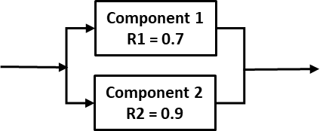
Reliability Block Diagrams, Simulation Redundant Parallel Systems
Live Exercise
Improving the Reliability of a Redundant Parallel
System (1 out of 2)
Based on what we have reviewed which component should be improve? Why?
What is the new system reliability?
Why improve any component?

Slide 109
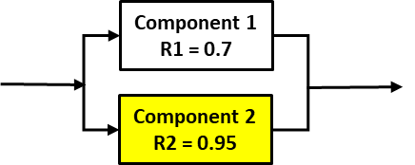
Reliability Block Diagrams, Simulation Redundant Parallel Systems
Live Exercise
Improving the Reliability of a Redundant Parallel
System (1 out of 2)
If we focus on the strongest component
The new system reliability is 98.5% (97.0%)

Slide 110
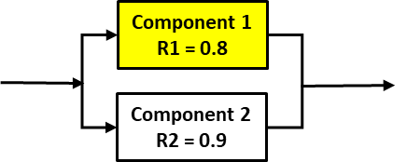
Reliability Block Diagrams, Simulation Redundant Parallel Systems
Live Exercise
Improving the Reliability of a Redundant Parallel
System (1 out of 2)
If we focus on the weakest component
The new system reliability is 98.0% (97.0%)

Slide 111
Reliability Block Diagrams, Simulation Redundant Parallel Systems
  Improving the Reliability of a Redundant Parallel
  System (2 out of 3)
Our first inclination is to fix the weakest component
Only by using a simulation technique can we determine the most cost-effective course of action

Slide 112
Reliability Block Diagrams, Simulation Complex Systems
A Complex System is made up of series and parallel subsystems.
A Complex System is harder to determine what component will improve system reliability without a simulation technique or software

Slide 113
Reliability Block Diagrams, Simulation Complex Systems
Quick Review of the Rules:
Series System is dominated by its weakest component
Non-Redundant Parallel System is dominated by the weakest component
Redundant Parallel Systems (K of out N) can be dominated by the strongest or the weakest component

Slide 114
Reliability Block Diagrams, Simulation Complex Systems
Improving the reliability of a Complex System
Pumps
K out of N
Desolation
Unit
Process
Unit
Raw
Material
WIP
Tank

Slide 115
Reliability Block Diagrams, Simulation Complex Systems
Calculate the reliability of the parallel components

Slide 116
Reliability Block Diagrams, Simulation Complex Systems
Reduce the Series components

Slide 117
Reliability Block Diagrams, Simulation Complex Systems
The Reduce the Parallel system

Slide 118
Reliability Block Diagrams, Simulation Complex Systems
Interactive Simulation of the System

Slide 119
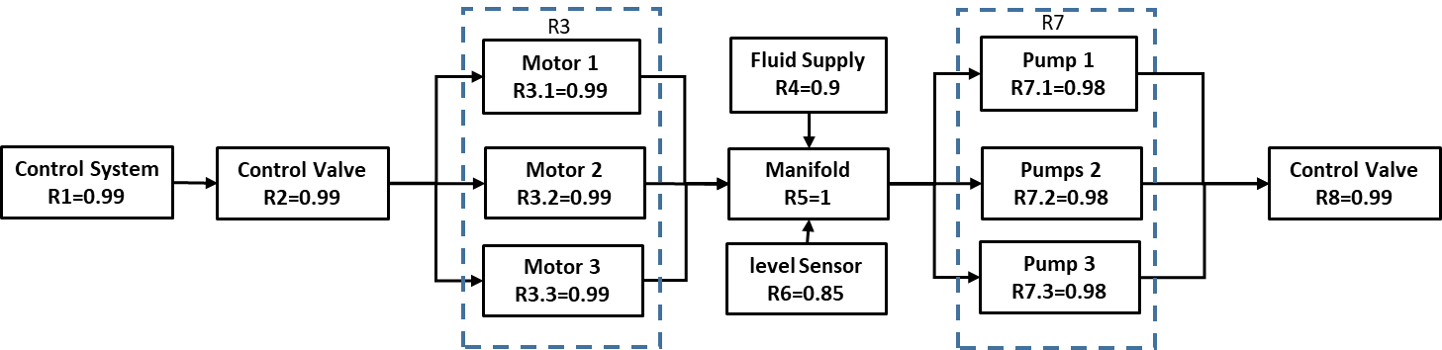
Reliability Block Diagrams, Simulation Complex Systems
Want to play a game?
Determine the reliability of this system
R3 and R7 are Non-Redundant, all three must run

Slide 120
Reliability Block Diagrams, Simulation Complex Systems
Reduce System Complexity

Slide 121
Reliability Block Diagrams, Simulation Complex Systems
Reduce the System to a Series

Slide 122
Reliability Block Diagrams, Simulation Complex Systems
Interactive Simulation of the System

Slide 123
Reliability Block Diagrams Summary
Reliability Block Diagrams (RBD) enables the Reliability Engineer to visualize a complex system and all its interrelated components
  Each block represents a component in the system and its relationship to the entire system
In a Series or Parallel systems If any one component fails, the entire system fails

Slide 124
Reliability Block Diagrams Summary
In a redundant parallel system, all components must fail for the entire system to fail
  Component (pump swapping) swapping is required to validate that the redundant (spare) component is fully operational when required
In a Non-Redundant parallel system, failure of single components may reduce performance or cause the entire system may fail
  The level of failure highly depends on system design and operating parameters

Slide 125
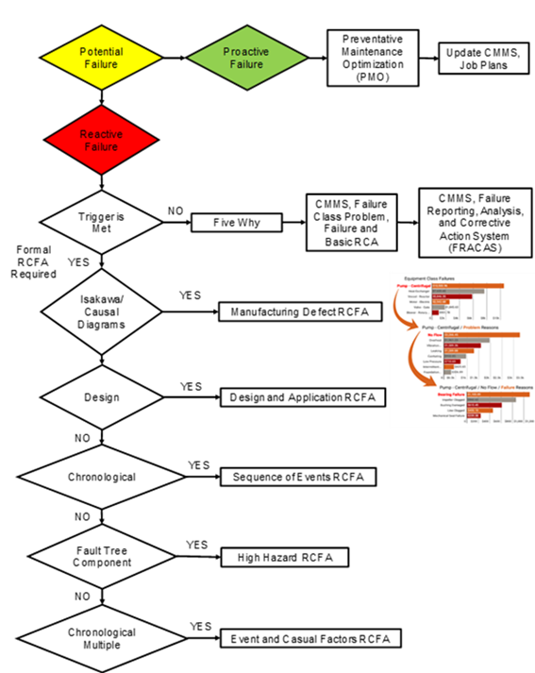
Workshop Conclusion
We have demonstrated the power of Non-Parametric and Parametric Analysis
We have demonstrated how to use Reliability Block Diagrams to identify you Reliability Initiative starting point
The final steps is to execute a structured Root Cause Failure Analysis process to eliminate or mitigate the latent root cause of your unreliability issues

Slide 126
Workshop Conclusion
If you take the tools that help you manage your assets reliability and you get rid of the underlying understanding of what reliability really is……
You’re left with just the tools…

Slide 128
Contact Information
Dale Uitto, PMP, CMRP, REC
864 304 3681
dale.uitto@yahoo.com
Vincent Torres, Mechanical Engineer
Office: 970.266.9005
vtorres@pioneer-engineering.com

Slide 130
Weibull’s influence From Suspended or Censored Data
Appendix 1
Weibull’s Influence From Suspended or Censored Data

Slide 131
Weibull’s influence From Suspended Data
Suspended data is failure data from a different failure mode
Right Censored data is non-failure data
In Weibull’s analysis all data must have the same failure mode
  Suspended or censored data will influence the Weibull’s plot
To get some understanding of the influence look at the Weibull’s graphs below

Slide 132
Weibull’s influence From Suspended or Censored Data

Slide 133
Weibull’s influence From Suspended Data
This is a copy of the code we will be using in R
library(WeibullR)
Seal_Failures<-c(30, 49, 82, 90, 96)
MRRw2p(Seal_Failures)
Bearing_Suspensions<-c(100, 45, 10)
fit<-MRRw2p(Seal_Failures, Bearing_Suspensions, bounds=TRUE, show=TRUE)
obj1<-wblr(Seal_Failures)
obj1<-wblr.fit(obj1, col="red")
obj1<-wblr.conf(obj1, lwd=1)
plot(obj1)
obj2<-wblr.conf(wblr.fit(wblr(Bearing_Failures, Bearing_Suspensions, col="purple"),),lwd=1)
plot.wblr(list(obj1, obj2))

Slide 134
Weibull’s influence From Suspended Data
Seal Failures only
β = Slope 2.168
η (eta) = 79.79
R² = 93.1%
R(28.26) = 90%
Red Line
With Suspensions
β = Slope 2.033
η (eta) = 94.93
R² = 95.31
R(28.26) = 91.84%
Purple Line

Slide 135
Weibull’s influence From Suspended Data
What influence did the suspended data have
The slope β (beta) hardly moved (2.168 - 2.033)
The Characteristic Life η (eta) increased from 79.79 to 94.93
Reliability R(28.26) changed from 90% to 91.84%
This affective is generally true when adding suspended data
But has the true pump reliability R(t) been skewed?

Slide 136
Weibull’s with Multiple Failure Modes
This is the lines of code we will input into R
Bearing Failures
library(WeibullR)
Bearing_Failures<-c(10,45,100)
MRRw2p(Bearing_Failures)
fit<-MRRw2p(Bearing_Failures, bounds=TRUE, show=TRUE)

Slide 137
Weibull’s with Multiple Failure Modes
Bearing Failures
The slope β (beta) is 0.8281 (Infant Mortality)
The Characteristic Life η (eta) is 61.87

Slide 138
Weibull’s with Multiple Failure Modes
This is the lines of code we will input into R
All Failure Modes
library(WeibullR)
All_Failures<-c(10,30,45,49,82,90,96,100)
MRRw2p(All_Failures)
fit<-MRRw2p(All_Failures, bounds=TRUE, show=TRUE)

Slide 139
Weibull’s with Multiple Failure Modes
We have mixed Bearing Failures (infant mortality) and Seal Failures (early wear out)
What was the influence?
The slope β (beta) moved significantly 2.168 to 1.443 (closer to Infant Mortality)
The Characteristic Life η (eta) increased from 79.79 to 73.08

Slide 140
So what is our Pumps Reliability
Bearing Failures
The slope β (beta) is 0.8281
The Characteristic Life η (eta) is 61.87
R(28.26) = 59.30%
Seal Failures
The slope β (beta) is 2.168
The Characteristic Life η (eta) is 79.79
R(28.26) = 90%
By combining Bearing and Seal Failures
The slope β (beta) is 1.443
The Characteristic Life η (eta) is 73.08
R(28.26) = 77.6% (This gives a false sense of reliability)

Slide 141
Bathtub Curve
Appendix 2
Weibull’s and the Conditional Probability of Failure Curves

Slide 142
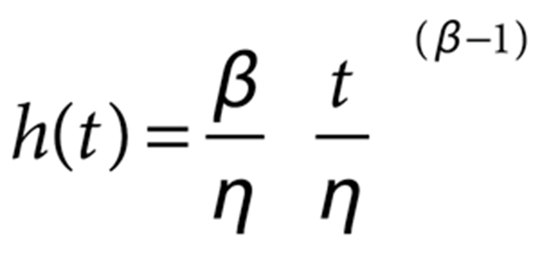
Weibull's Hazzard Rate
The hazard rate describes how a population is failing at a given time or Instantaneous Failure Rate
Plotting Hazard Rate produces the Conditional Probability of Failure Curves i.e. Bath Tub Curve
The hazard rate (h) and beta (β) have a distinct relationship
When β < 1, the hazard rate decreases with time, reflects infant mortality
When β=1, the hazard rate is constant over time.
When β > 1, the hazard rate increases with time, wear out is an increasing rate

Slide 143
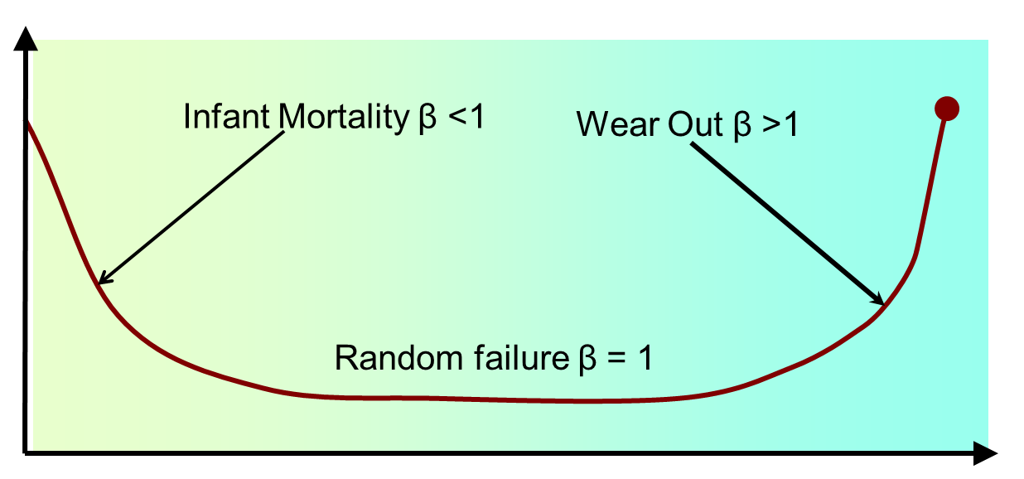

Parametric Analysis
Weibull's Hazzard Rate
If you plot the Hazard Rate over the populations life it produces the Conditional Probability of Failure Curves

Slide 144
Weibull’s Analysis and the P-F Curve
Appendix 3
Weibull’s Analysis and the P-F Curve

Slide 145
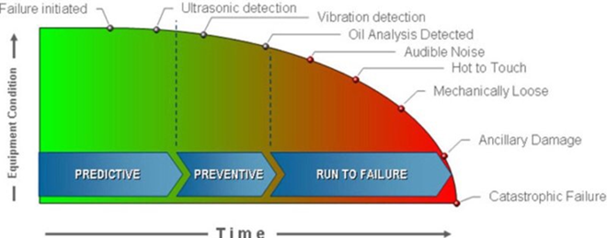
Weibull’s Analysis and the P-F Curve
When a component has multiple failure modes
Failures from the secondary failure mode may never occur
  Unless the first failure mode is eliminated
  or the component is purposely Ran to Failure
Therefore outside of research the P-F curve should be considered theoretical

Slide 146
Other Functions in R
Appendix 4
Calculating Mean, Median, Std Dev in R

Slide 147
Other Functions in R
Seal_Failures<-c(30, 49, 82, 90, 96)
mean(Seal_Failures)
  [1] 69.4
var(Seal_Failures)
  [1] 814.8
summary(Seal_Failures)
  Min. 1st Qu. Median Mean 3rd Qu. Max.
  30.0 49.0 82.0 69.4 90.0 96.0
sd(Seal_Failures, na.rm = FALSE)
  [1] 28.5447
Plot Histogram
  hist(Seal_Failures)

Slide 148
Maximum Likelihood Estimation (MLE) in R
Appendix 5
Maximum Likelihood Estimation (MLE)

Slide 149
Maximum Likelihood Estimation (MLE) in R
Parameter estimation using Maximum Likelihood Estimation (MLE) in R
library(survival)
d <- data.frame(ob=c(30, 49, 82, 90, 96), state=1)
s <- Surv(d$ob,d$state)
sr <- survreg(s~1,dist="weibull")
print(paste("beta =",1/sr$scale))
  [1] "beta = 3.20182232000233"
print(paste("eta =",exp(sr$coefficients[1])))
[1] "eta = 77.8615291227799"
The MLE method has its drawbacks, it is biased when only a small number of observations are used, population of 5
A bias reduction method exists (MLE-RBA) but it does not completely remove the bias
MLE β = 3.2018, MRR = 2.168
MLE η = 77.86, MRR = 79.79

Slide 150
Installing R and WeibullR
Appendix 6
Installing R and WeibullR

Slide 151
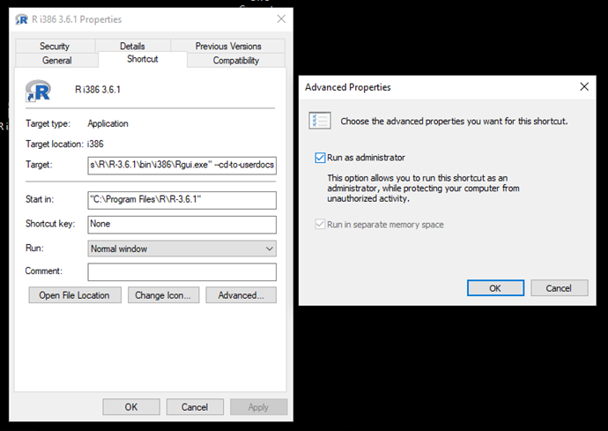
Installing R
Installing R
R is downloaded via the official R-Project web page, https://www.r-project.org/
Select a download mirror (site) and follow the installation instructions for your operating system
Right click on Icon, Properties, Shortcut, Advanced, check “Run as Administrator”

Slide 152
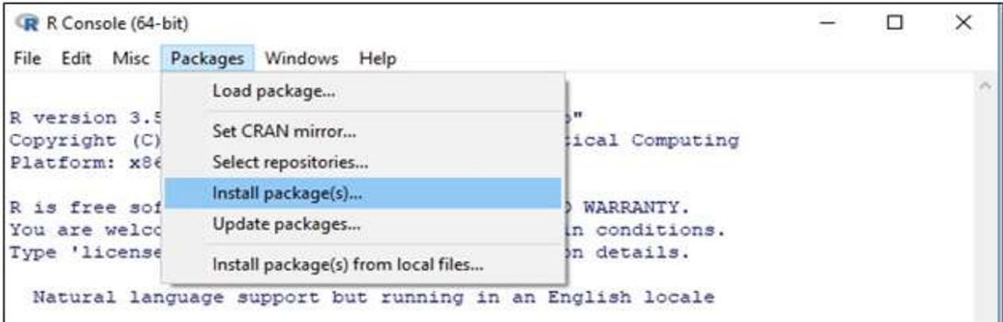
Installing WeibullR
  Installing the WeibullR Package (one time installation)
  Open R
  Click of “Packages”
  Click on “Install Package(s)”
  Select a download mirror (just like it did on your R download)
  Scroll way down the alphabetic list to select and click on “WeibullR”
    Success is noted by the following message: package ‘WeibullR’ successfully unpacked and MD5 sums checked

